Slide 1
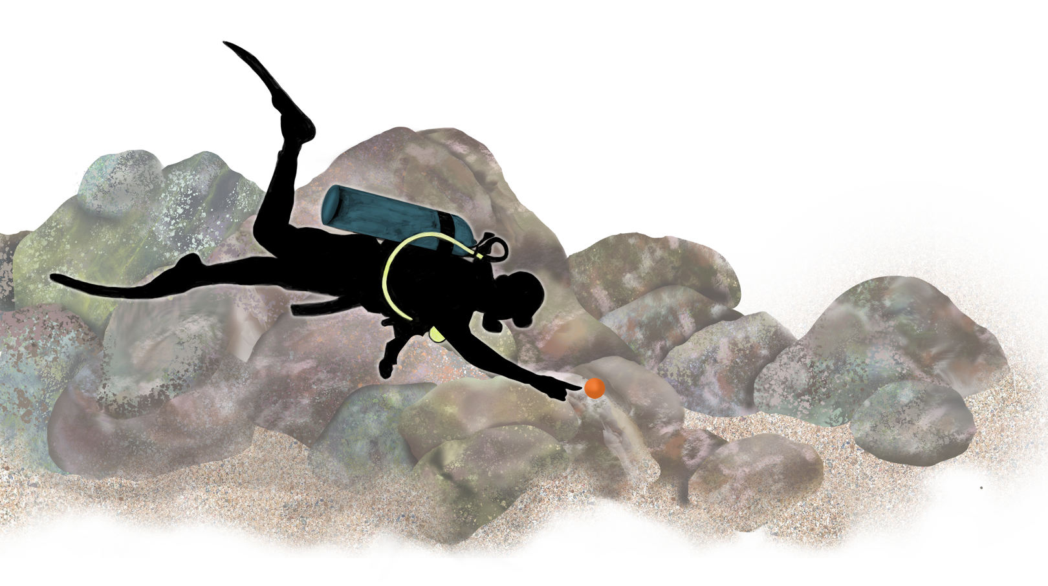
Step 1: Identify the point on the Transect Tape.
Example #1
Notes:
1

Slide 2
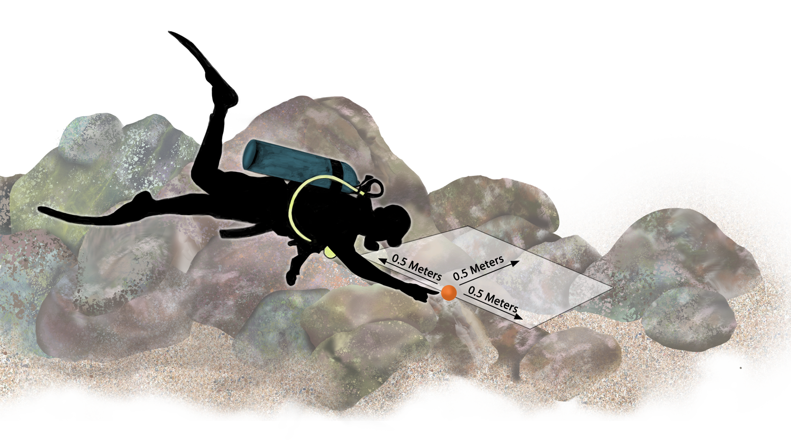
Step 2: Draw a box 5 meters in each direction
from the point.
Example #1
Notes:
2

Slide 3
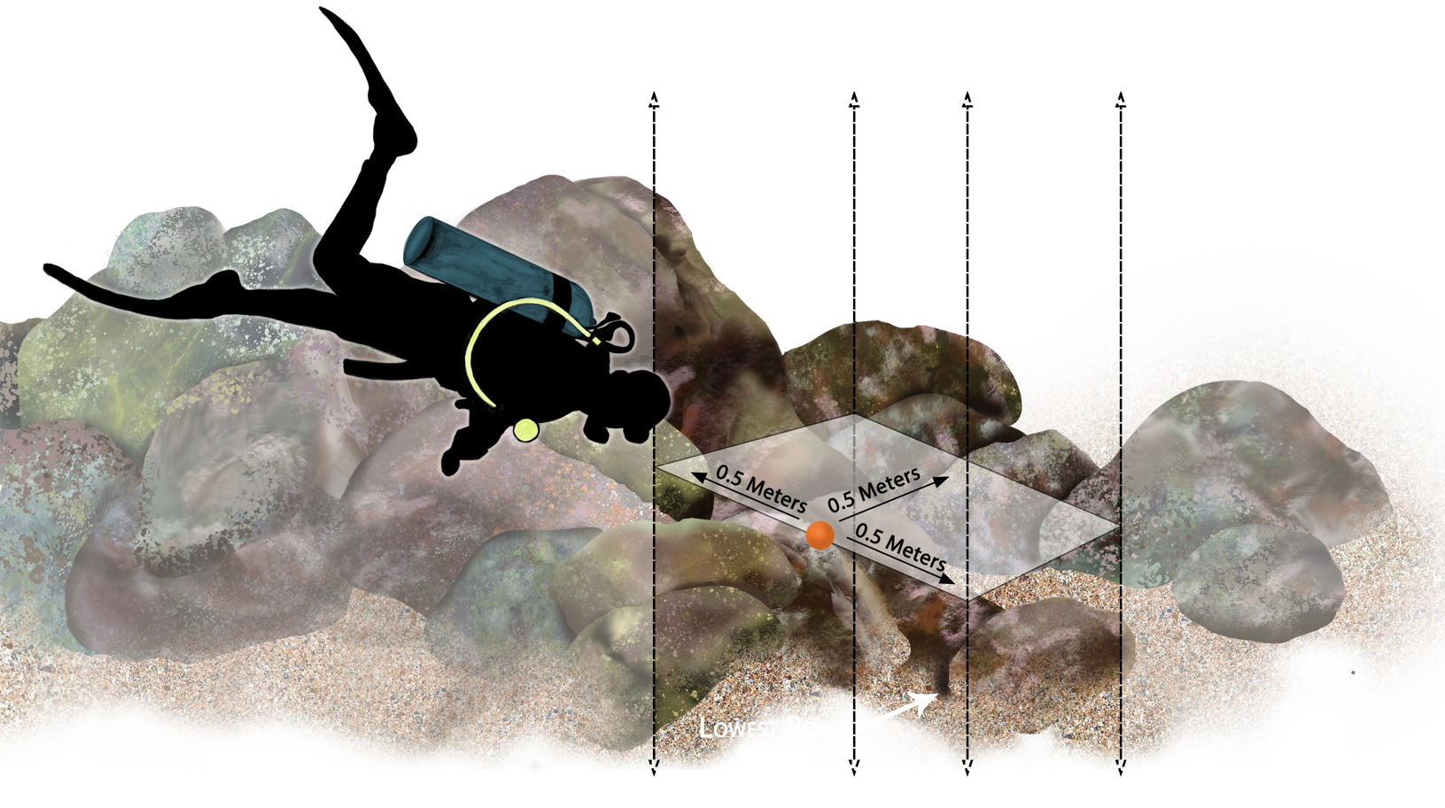
Step 3: Identify the highest & lowest points within the area defined by the box.
Example #1
Notes:
3

Slide 4
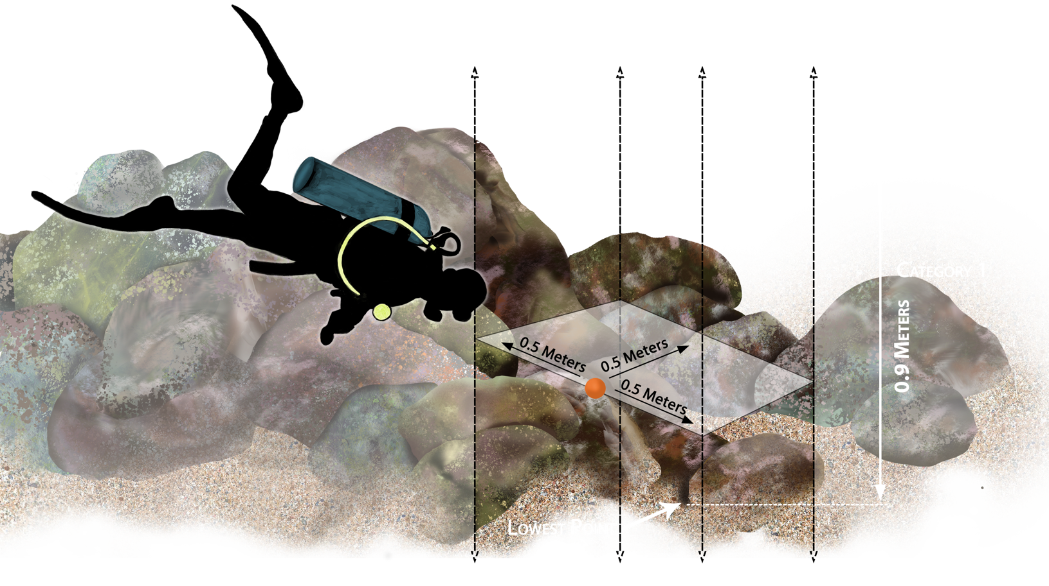
Step 4: Measure the distance between the highest & lowest points.
Example #1
Notes:
4

